Slide 1
PFP 304 Interviewing and Investigations

Slide 2
Course Outline and Expectations
To be handed out

Slide 3
Note Taking
Notes made by officer
- called “field notes”
- written at time
- for final report
- need not be saved (policy)
Not unique to police
- news reporters
- doctors
- lawyers and judges
- students

Slide 4
Note taking, cont.
3. Notes: brief records
- what is seen / heard
a. Investigative notes
- permanent written record of facts
b. Further investigation
c. Writing the report
d. Prosecuting the case

Slide 5
Note taking, cont.
Reports based on fact
- come from your notes
a. A continual process
- it is a record of all information
b. Not in your notes
- may not go into report
c. Not in report / hard to justify

Slide 6
Note taking, cont.
Fail to take proper notes
- embarrassing
a. Front of detectives
b. Front of superior officers
c. Front of court
- you wrote from memory - the next day

Slide 7
Preparing to Take Notes
Basis for the written report
Taken in chronological order
Headings used for clarity
- assignment / arrival / contact / search / evidence / conclusion
Can be subpoenaed
- loose-leaf vs. bound
- pocket notebook / writing tablet

Slide 8
What notes are used for
Writing report
- expand upon notes taken
Making sketches / diagrams
- measurements taken for a professional sketch
Testify in court
Further investigation

Slide 9
When to take notes
As information is received
- or immediately thereafter
Soon as possible
- after receiving call
Continue as received
When impossible
- remember / write asap

Slide 10
Write in past tense / first person
“Mr. Rogers said he worked at . . . .”
- “I arrived at 2200 hours . . . .”
- “I took photographs of . . . .”
a. Present tense
- not applicable in court
Write in first person
- I / me / my / we / us / our
- “I contacted Mr. Smith at . . . .”

Slide 11
What to record
Information to answer: when / where / who / what / why / how
When – happen / discovered / reported / did police arrive?
Where – crime happen / evidence found / do witnesses live / suspects frequent most often?
Who – are suspects / accomplices / victims / saw or heard something / was talked to?

Slide 12
What to record, cont.
What – type of crime / was damaged / was value of property / was said?
Why – a particular crime / certain property taken / crime committed?
How – crime discovered / crime compare / crime occurred / evidence found?
- ask specific questions
- depends on crime
- how committed

Slide 13
Be objective
No emotional overtones
“Stated” / “claimed”
- be ready to defend in court
- use “said”
No conclusionary language
- be concise
- avoid wordiness
- simplify and clarify (thesaurus / dictionary)

Slide 14
Be objective, cont.
1. Use simple words / publicly accepted
2. Good understanding of spelling / punctuation / sentence structure
3. Stay away from abbreviations (unless necessary)
4. Capitalize last names

Slide 15
Note Taking: Investigations
https://www.youtube.com/watch?v=efpTyQ49zxA

Slide 16
Okay lets look at some crime scene Notes…

Slide 17
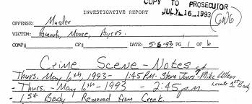
Crime Scene Note Taking

Slide 18
CS Notes
Who?
–Who were victims, witnesses, and suspects.
–Provide full description of suspect and vehicles.
•Age, height, weight, skin color, hair color/style, voice, tattoos, and clothing
•Obtain as much information as possible for victims/suspects including place of employment
•Make, model, style, and color of vehicle if possible
•What?
–What type of crime occurred
–What damage or injury was caused
–What happened
–What was said
–What evidence was found
•Where?
–Where did crime occur
–Where was evidence found
–Where do victims, witnesses, and suspects live

Slide 19
CS Notes
When?
–When did crime occur
•If exact date/time not know develop time range
–When were the Police called
–When did the Police arrive
–When were suspects arrested
•Why?
–Why was crime committed at this location
–Why was crime committed at this time
–Was there motive or intent
–Was a specific person or piece of property targeted?
•How?
–How was crime discovered
–How did the crime occur
–How was evidence found

Slide 20
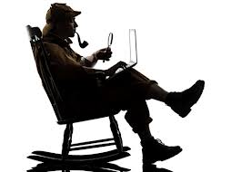
Guidelines
•Write brief, legible, abbreviated notes that others will be able to understand.
Notes in INK
Bound notebook
Mistakes crossed out with single line
Pages numbered consecutively
Pages initialed

Slide 21
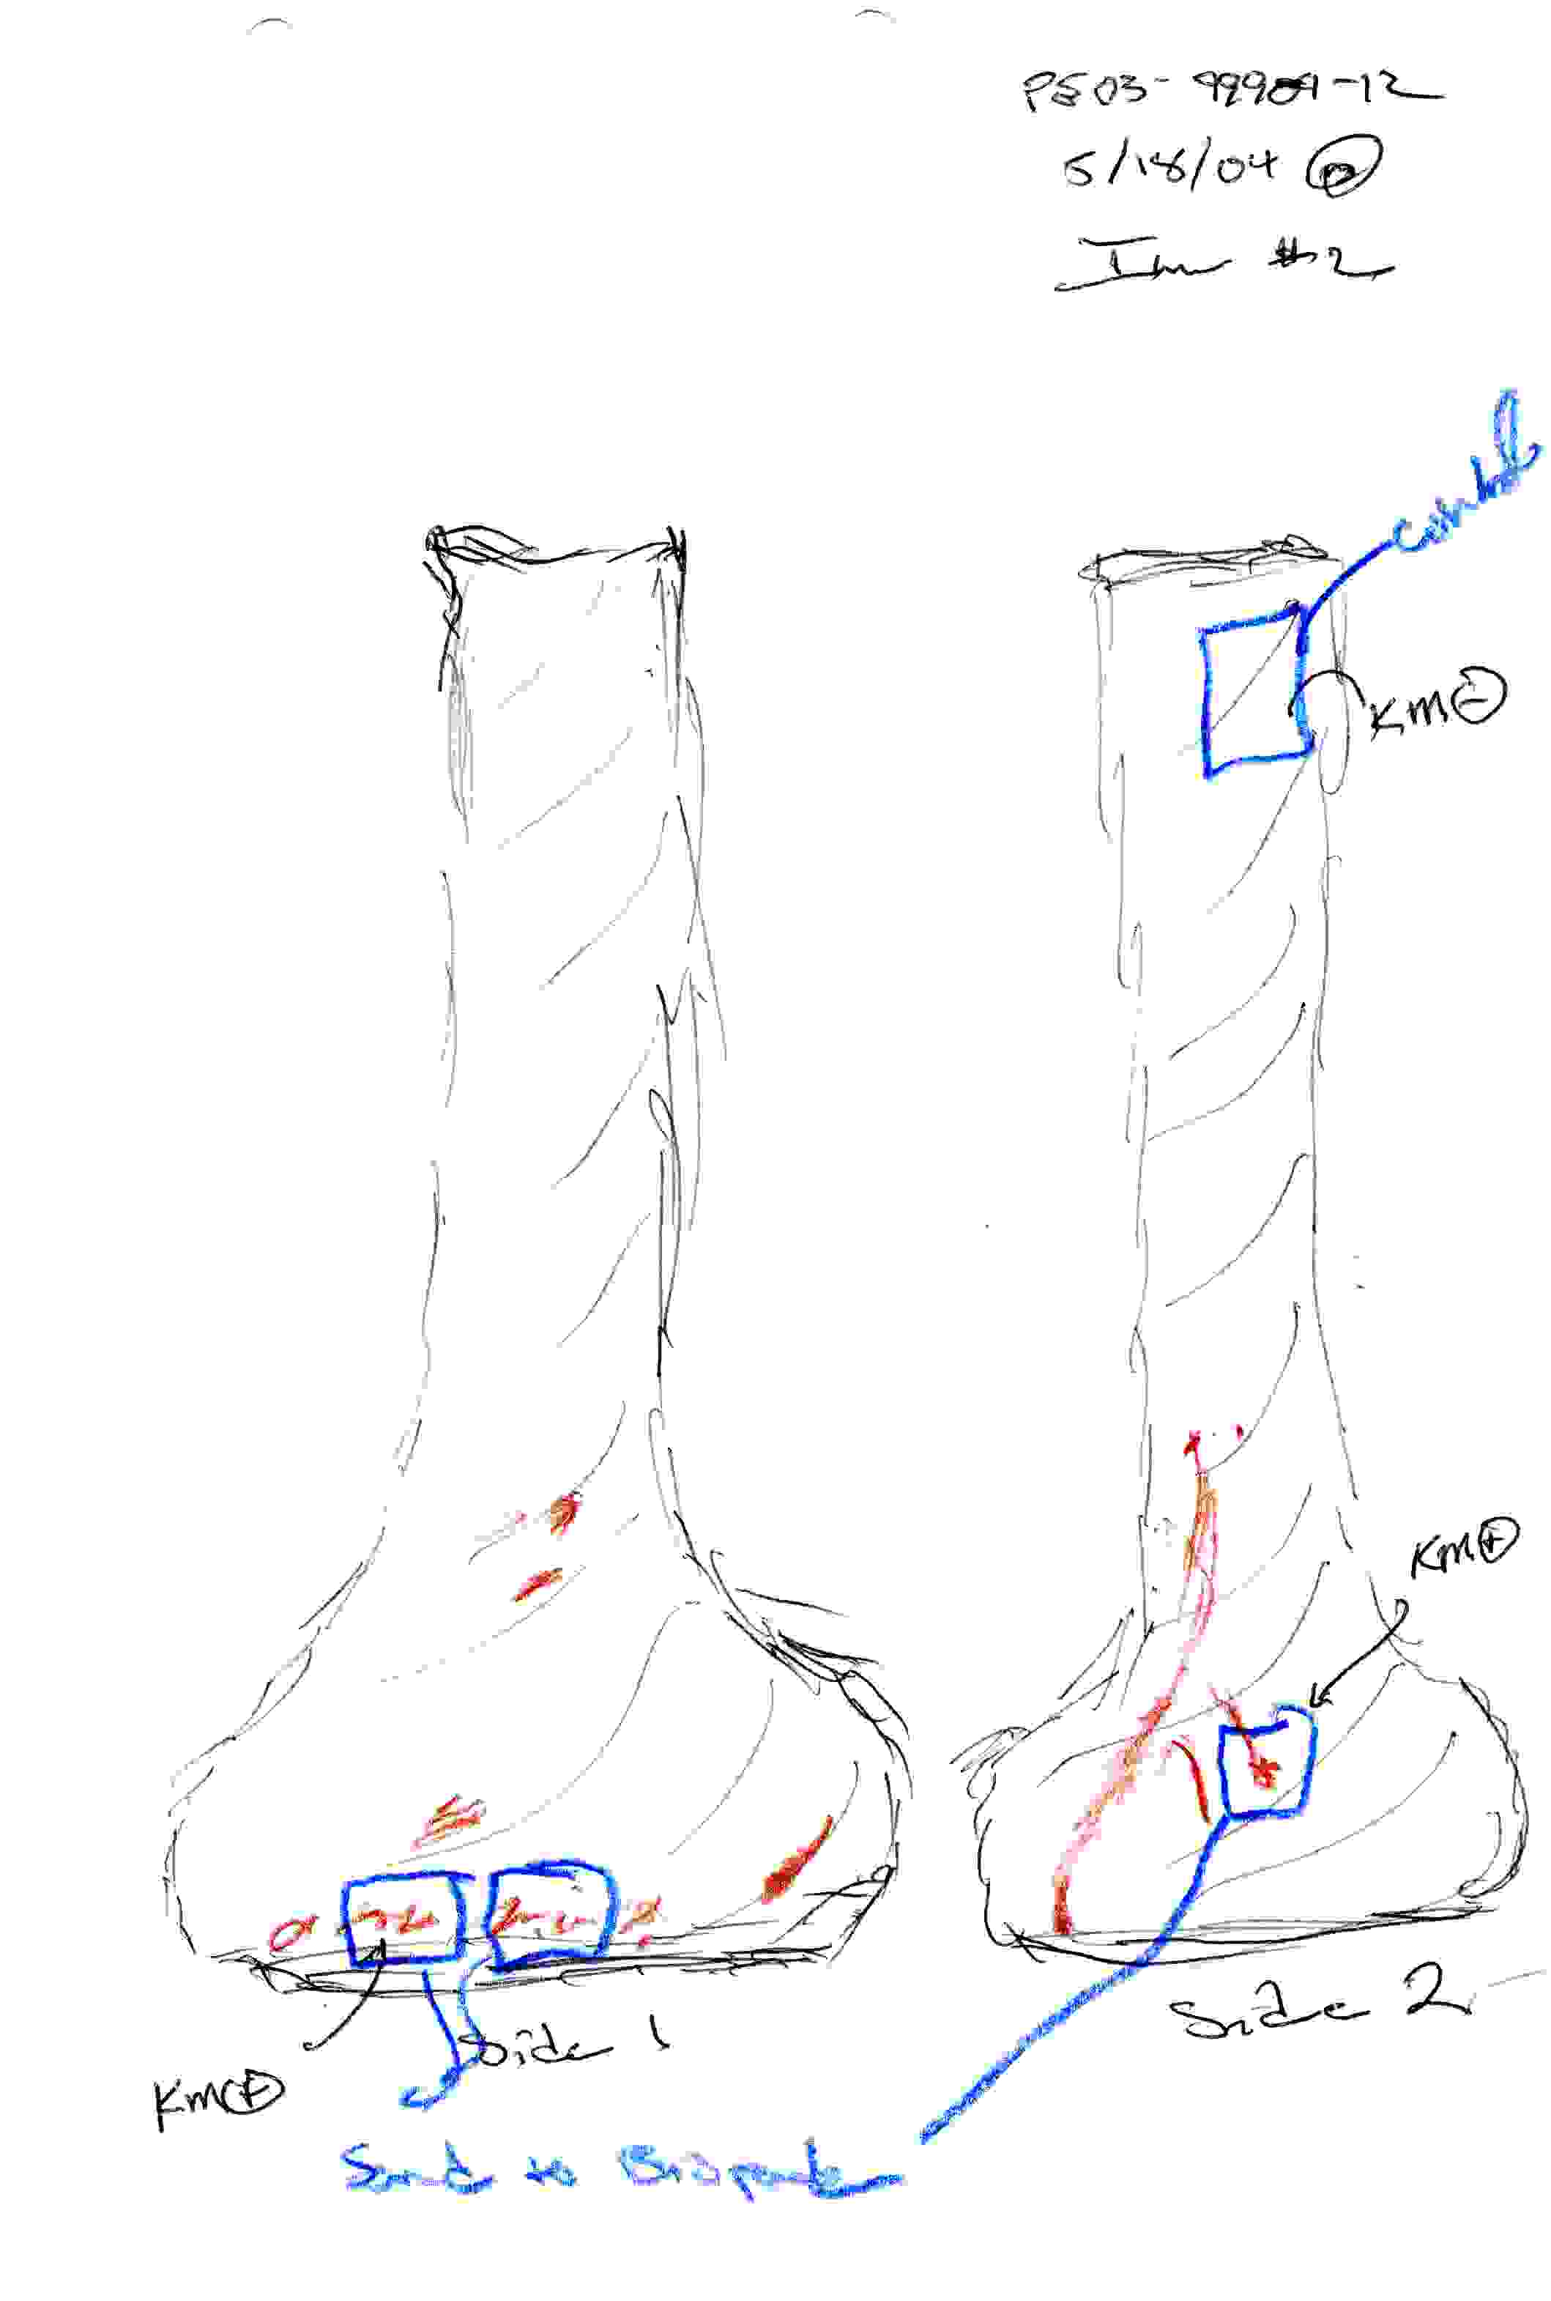
Crime Scene Investigation

Slide 22
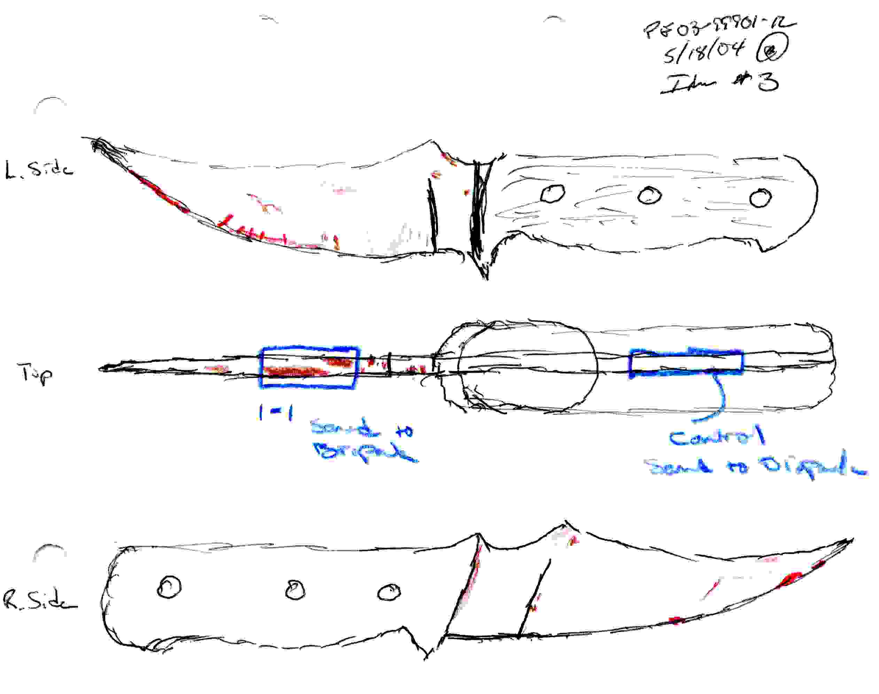
Crime Scene Investigation

Slide 23
Typically…
The notes and reports should be done in a chronological order and should include no opinions, no analysis, or no conclusions. Just the facts!!!! Document what is seen, not what one thinks. The final report should tell a descriptive story. A general description of the crime scene should be given just as the investigator sees it when he/she does the initial walk through of the scene.

Slide 24
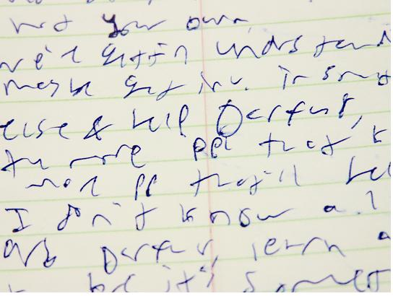
ONE LINE THROUGH MISTAKES !!!! NO ERASERS!!!
Only valid in court if procedure is followed

Slide 27
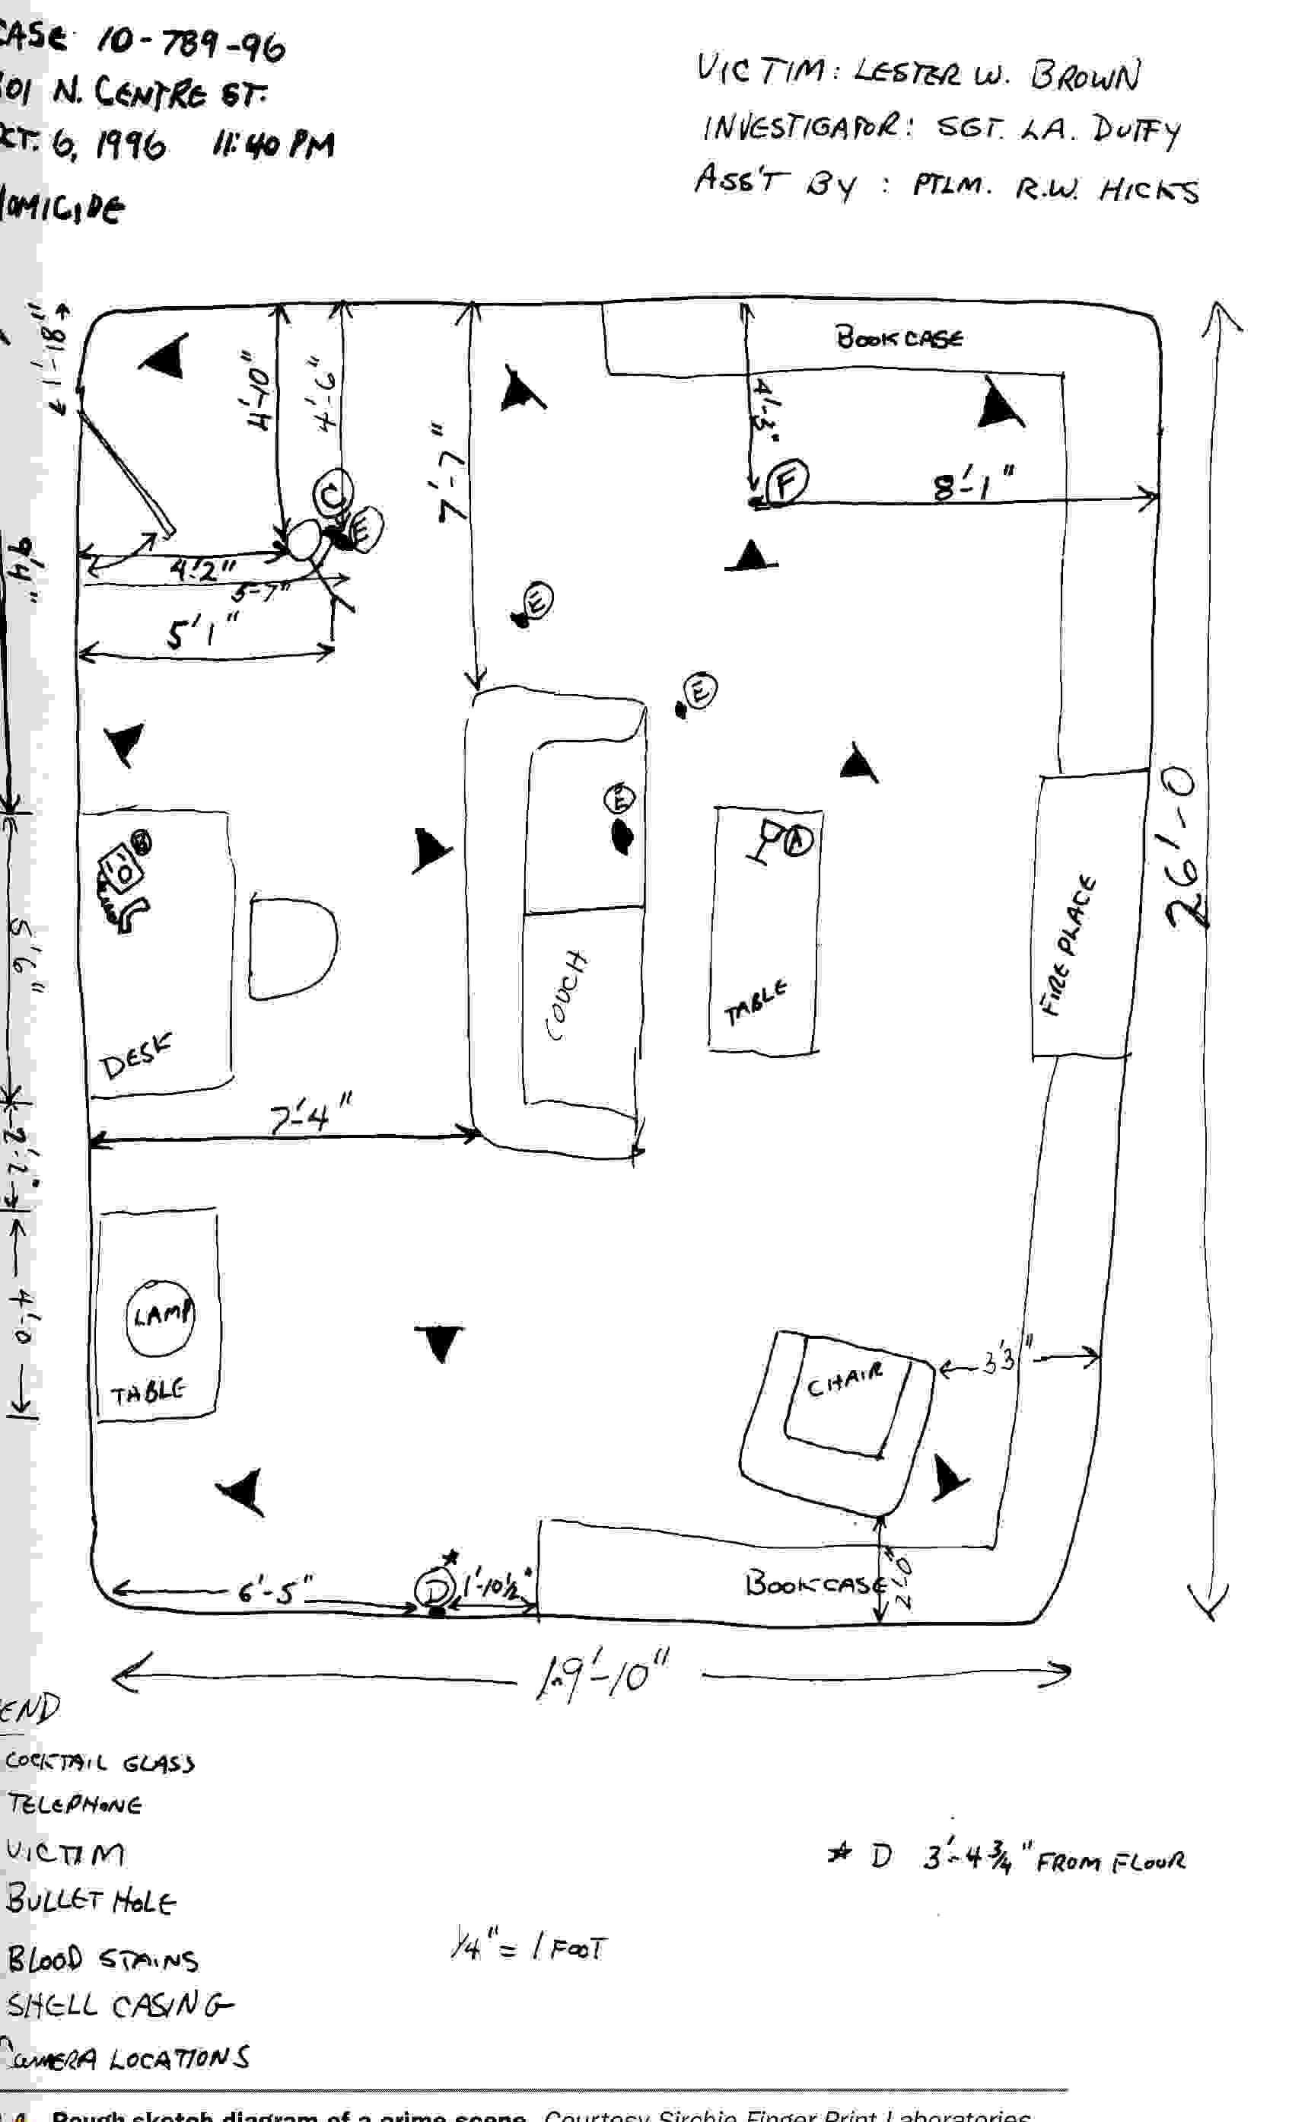
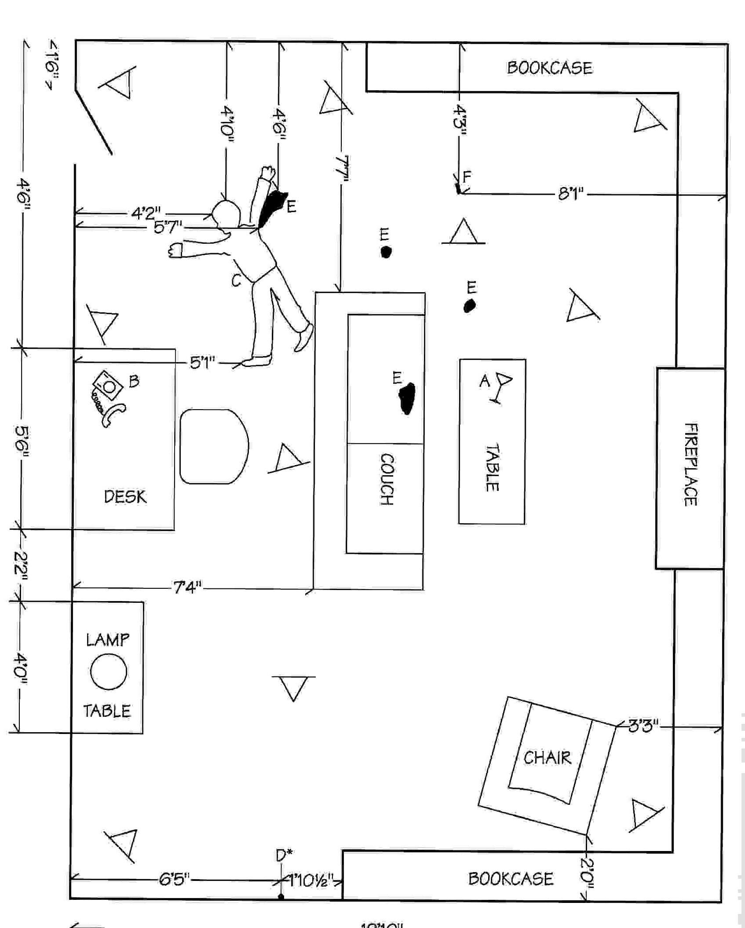
Crime Scene Investigation

Slide 28
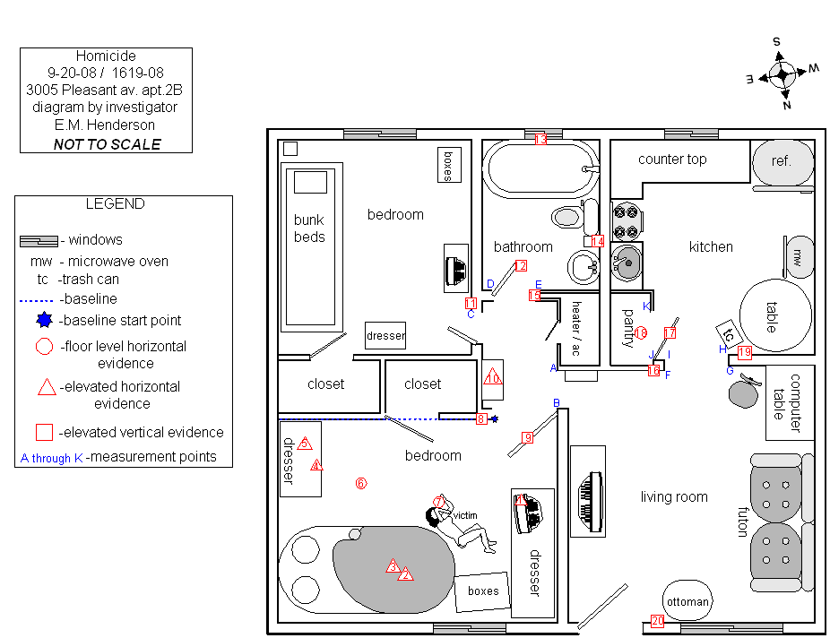

Slide 29
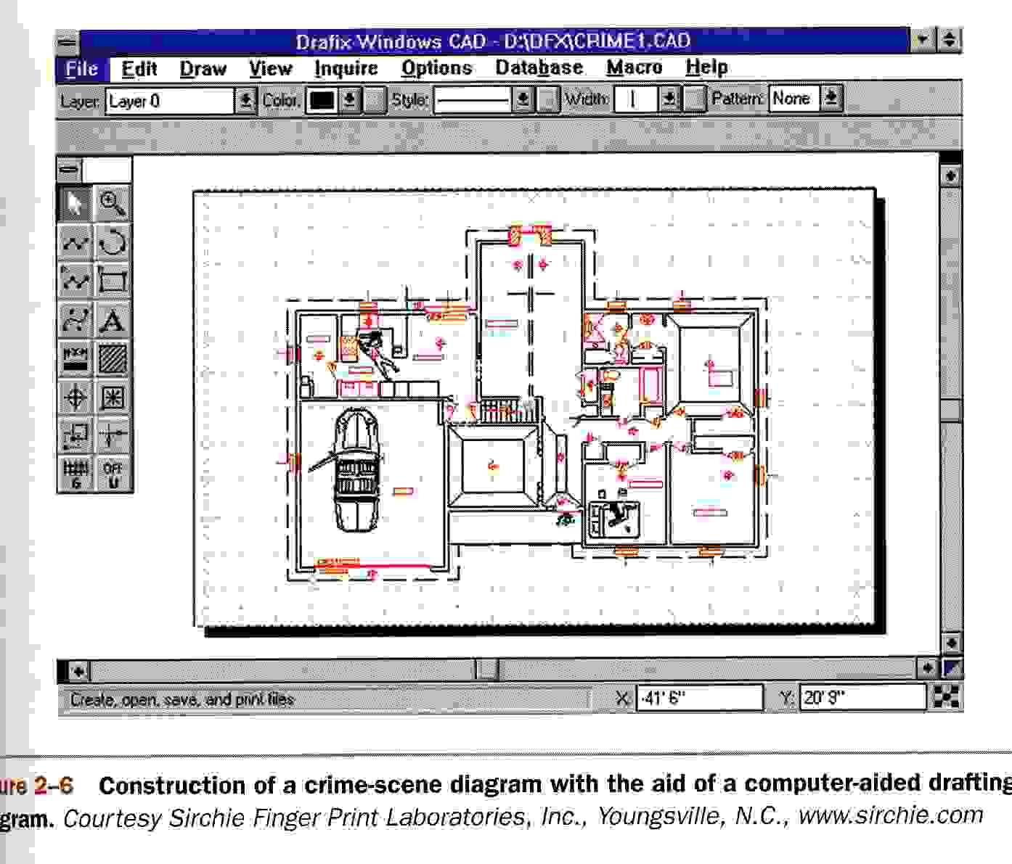
Crime Scene Investigation

Slide 30
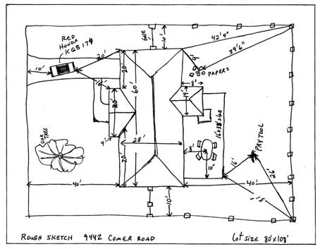

Slide 31
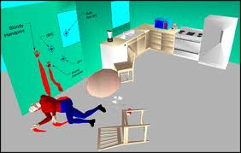

Slide 32
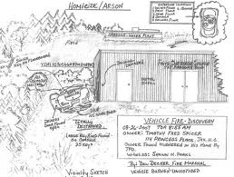

Slide 33
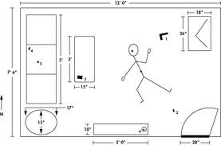

Slide 34
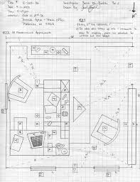

Slide 35
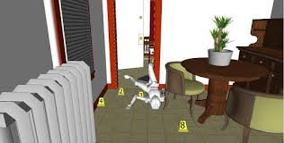

Slide 36
Practice Incident Note Taking
https://www.youtube.com/watch?v=hY1LukxY4c4

Slide 37
Reading: Chapter 1

